Slide 1


Enhancing Inside Sales Productivity for Cement Retail Accounts Transitioned from Field Acquisition
JSW One , Contruct & Retail
Intern Name: Vidhi Shah, Karan Rao Mentor: Mr. Bhrugesh Chauhan Buddy: Mr. Sanjay Datta Gupta (AGM-Retail), Ms Srushti Sindagi

Slide 2




Business Overview
About JSW One:-
JSW Group has launched JSW One MSME - a digital e-commerce platform for all steel and cement purchases.
At JSW One MSME, one can purchase multi-brand steel and cement of their choice at competitive prices, with doorstep delivery. We aspire to bring them the promise of transparency, trust, quality product, timely delivery, and after-sales support. We will assist them with the journey at every step of the way.
About Retail Business:-
Produces the goods using the machines, raw materials and labour
Purchase goods from manufacturers and sell them to retailers in bulk quantities.
Sell the goods in small quantities to the end-user at a higher price.
End-user who buys the goods from the retailers for personal use.

Slide 3




Our objective
To increase monthly sales productivity from 500 MT to 2000 MT by building a data-driven account
CONVERSION RATE ANALYSIS
Calculated opportunity to order conversion % across:-
States and Account priority segments
LOST ACCOUNT ANALYSIS
Studied lost accounts and reasons across key states to identify drop-off patterns.
ACCOUNT PRIORITIZATION USING THE COX MODEL
Ranked accounts based on:- Order Frequency, Order Volume, Months since last order
UPLIFT BENCHMARKING MODEL
Developed benchmarks to uplift statewise conversion rates and identified realistic improvement targets based on peer performance.

Slide 4
Data References (1300+ Customers)
1.ORDERS & RETAIL TRACKER (LAST 5 MONTHS)
Analyzed customer buying trends and order patterns.
Tracked orders by customer, product, and region.
Built customer profiles by purchase frequency and volume and assigned priorities to the customers
2. LOST ORDERS ANALYSIS (LAST 5 MONTHS)
Identified reasons for order losses by state or district as shown in the table below.
Assessed both internal and external factors affecting order loss.
State | Problem 1 | Problem 2
Tamil Nadu | Price Discovery | Bidding/Price Discovery
Andhra Pradesh- Telangana | Bidding/Price Discovery | P-Same brand
Karnataka | P-same brand | Credit
Maharashtra | Credit | P-same Brand
West Bengal | Price Discovery | Bidding/Requirement cancelled/Delay

Slide 5
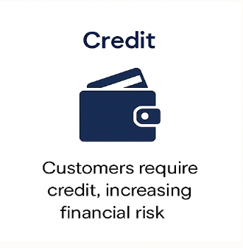
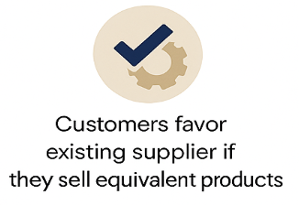
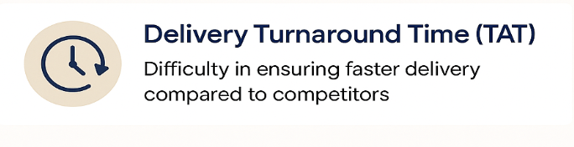
Key Challenges Faced
From the references we contacted
From the data we analyzed
Field Sales
Inside Sales
P - Same Brand
Longer Delivery TAT
One of the key challenges faced by the field sales team at JSW One is the longer Delivery Turnaround Time (TAT) compared to competitors.
While our current TAT stands at 2 days, competing firms are able to fulfill deliveries within just 1 day. This delay often puts our sales team at a disadvantage during client negotiations, as faster delivery is a critical decision-making factor for many customers.
Addressing this gap is essential to enhance our competitiveness and improve customer satisfaction.
Competitive Disadvantage
As a result, customers may perceive JSW as less responsive, which puts us at a competitive disadvantage.
.
Limited Customer Trust
Difficult to match the deep, long-standing customer relationships (15–20 years) that FS team members have established, resulting in lower customer confidence in IS
Relationship Building Barriers Face-to-face engagement is limited, making it harder for IS team members

Slide 6
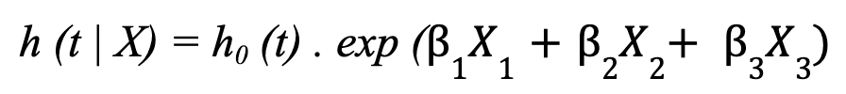
COX Hazard Model
The Cox Model is a semi- parametric statistical method used to predict the timing of events, such as customer churn or drop-off. It estimates how risk changes over time without assuming a fixed pattern or distribution. Ideal for real-world business scenarios, it works well even with incomplete or irregular data. It helps businesses prioritize actions by identifying which customers are most at risk and when.
Step 1
Cox Parameters:-
Step 2
Hazard ratio, to get it we put it in the below equation
Step 3
Prioritization basis the COX Score which we divided the scores into 50th and 75th percentile and then divided them from P1 to P4
Order Volume/month
Order Frequency/month
Months since last order
Here ẞ1= 0.00187 for the order volume/month
ẞ2= 0.169 for the order frequency/month
ẞ3= 1.109 for the months since last ordered
Priorities | Order Volume/Month | Order frequency/Month | Months since last ordered
P1 | H | H | H
P2 | H | M | H
P3 | M/L | L/M | M
P4 | L | L | L
H - High Value
M - Medium Value
L - Low Value

Slide 7
Advantages and Use-Cases of Cox Model
Time-Sensitive Insights: Unlike logistic regression, the Cox model doesn’t just say if churn will happen—it shows when it’s most likely, allowing for timely intervention.
No Need for Distribution Assumptions: It doesn’t require assuming a specific statistical distribution for customer behavior, making it more flexible and accurate in messy, real-world data.
Works Well with Censored Data: Customers who haven't churned yet (i.e., still active) are still usable in the model—this improves learning without biasing results.
Scalable to Large Customer Sets: Efficiently handles hundreds or thousands of customer timelines, as seen in your 1300+ account analysis.
Improves Targeting Efficiency: By converting raw behavior data into interpretable hazard ratios, it helps the sales team prioritize the right accounts with higher ROI.
Here as you can see in the table below that even if the order volumes are same then also the priorities have changed because the customer 1 has higher order frequency and number of months ordered count.
Customer | Order Volume/Month | Order freq/Month | No. of months ordered | Priority
1 | 28 | 2.4 | 5 | P1
2 | 28 | 2.3 | 3 | P2
In this case we can see that even if the order volume and number of months ordered are same but the order frequencies are different so the priorities become different.
Customer | Order Volume/Month | Order freq/Month | No. of months ordered | Priority
1 | 16 | 3.8 | 3 | P2
2 | 16 | 1 | 3 | P3
For this example, even if the order volume of P4 priority is more but it is ranked low because of the less order frequency and number of months ordered
Customer | Order Volume/Month | Order freq/Month | No. of months ordered | Priority
1 | 13 | 1.7 | 3 | P3
2 | 25 | 1 | 1 | P4

Slide 8
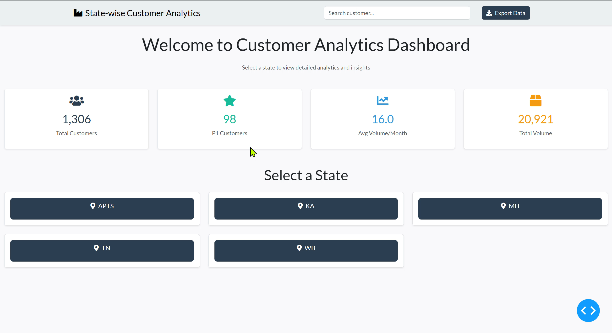

Slide 9
Desired Uplift in the Conversion Rates
Andhra Pradesh- Telangana
Karnataka
Maharashtra
Tamil Nadu
West Bengal
 | Vol% Median
P1 | 94.69
P2 | 70.83
P3 | 59.13
P4 | 30
 | Vol% Median
P1 | 72.51
P2 | 66.03
P3 | 50.49
P4 | 30
 | Vol% Median
P1 | 78.25
P2 | 61.47
P3 | 47.05
P4 | 30
 | Vol% Median
P1 | 99.91
P2 | 100
P3 | 100
P4 | 30
 | Vol% Median
P1 | 64.26
P2 | 55.37
P3 | 44.64
P4 | 30
754.8MT/Month
552.5MT/Month
679.7MT/Month
1137.3MT/Month
480.4MT/Month
Calculated Volume Conversion = Order Volume / Opportunity Volume.
Done separately for each priority and state.
Took median of Volume Conversions as the benchmark.
Benchmarks were set per priority per state.
Used these benchmarks on the dashboard.
Dashboard multiplies conversion value with: Number of customers per priority, and Volume ordered by them.
Result: Total volume (MT) recovered per month for each state.
Here is a live demonstration of the dashboard using an example in the next slide.

Slide 10
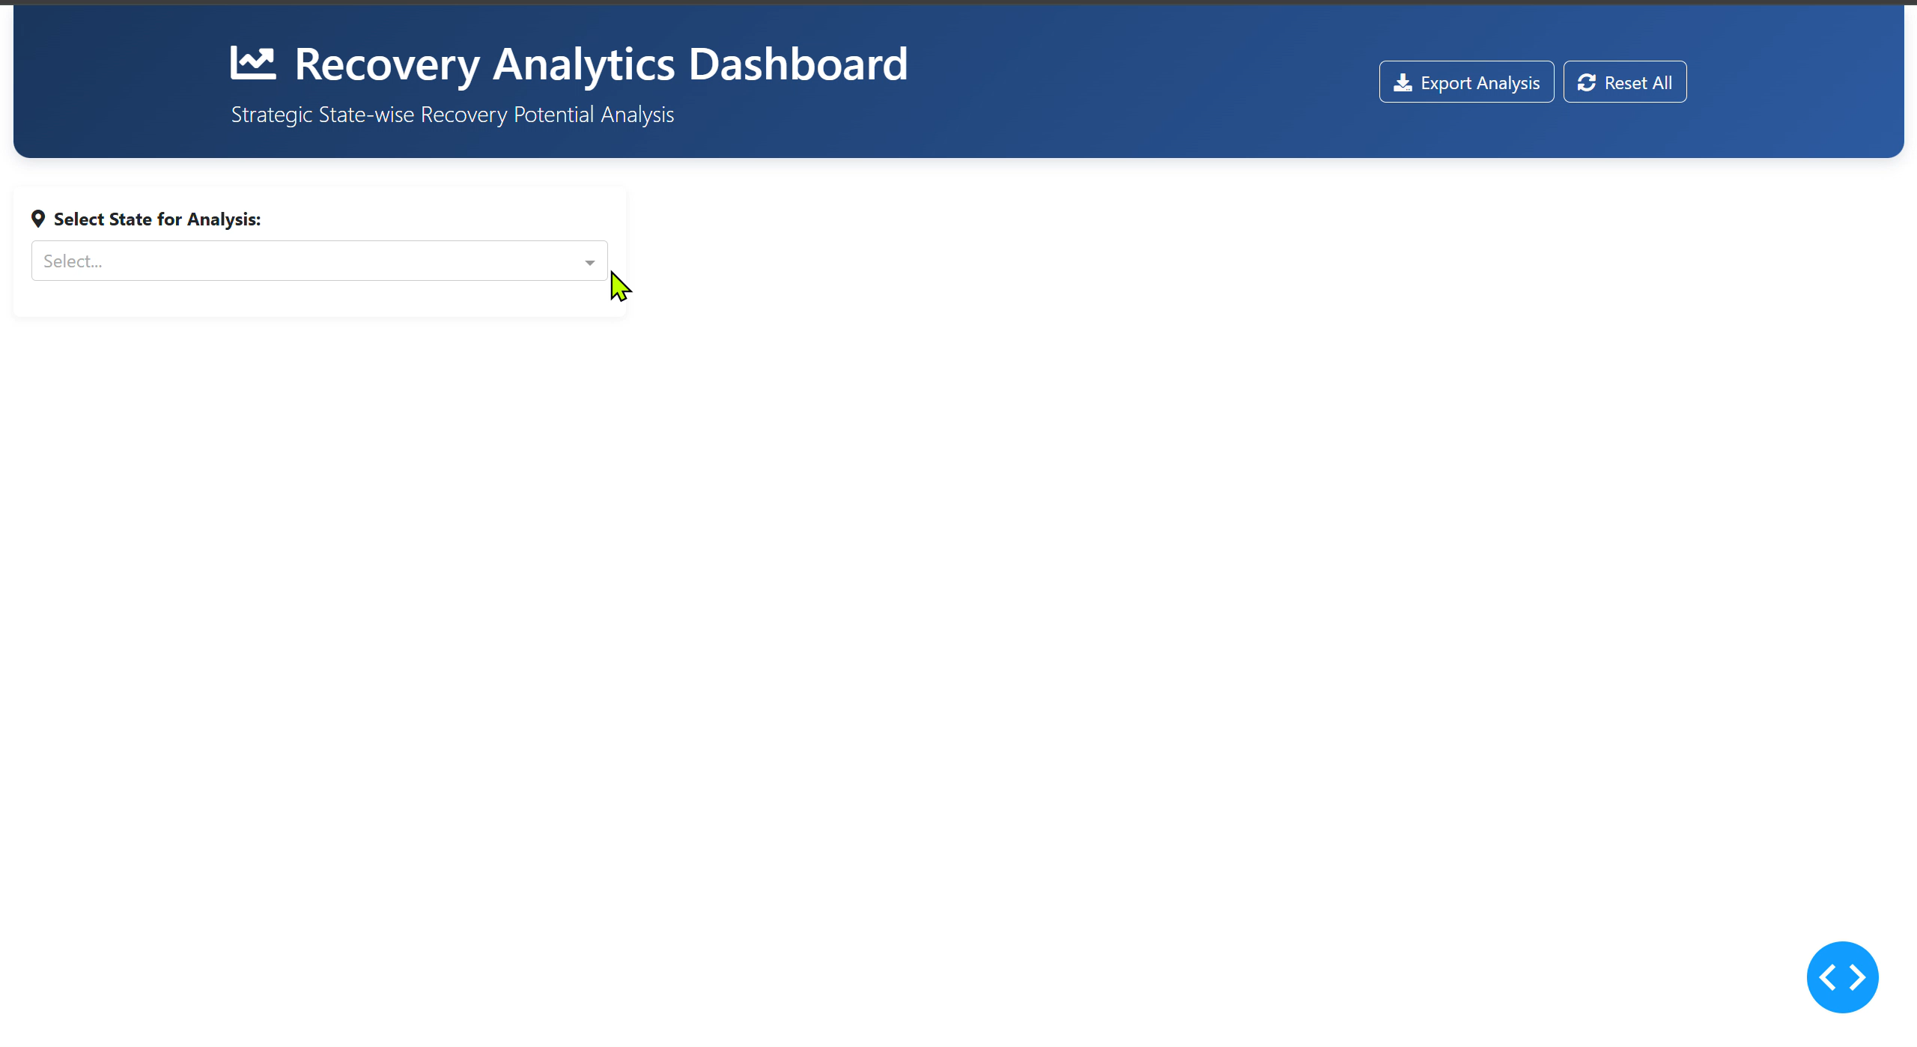

Slide 11
Looking forward
Priority-Driven Engagement Programs:
Problem-Centric Growth Strategies:
This means prioritizing our efforts and resources towards customer segments offering the highest potential for immediate returns and sales conversion
Resolving Credit Accessibility and sctivating Untapped Markets and issues related to P-same brands
Increment of sales productivity

Slide 12
Insights Gained
Credit & Margin Challenges
Retailers say JSW offers credit with interest, while competitors often give interest-free or dealer-backed rolling credit → retailers hesitate to take JSW credit.
Typical dealer margin only 2–3% → not enough to justify switching or pushing JSW vs existing brands.
No Perceived Value Addition
Retailers see JSW One as just another supplier, lacking unique benefits like loyalty schemes, credit insurance, or marketing support
Competitors run local branding, dealer boards, secondary sales promotions (e.g., Ultratech wall painting, ACC point boards) that JSW doesn’t match yet.
Process & Delivery Gaps
Product & Market Fit Issues
State-Specific Observations
Retailer Behaviour Patterns
Order fulfilment timeline: ~48 hrs vs competitors’ 24 hrs → slower, affecting conversion.
Field teams still dominate because retailers prefer face-to-face trust & quicker negotiation.
Retailers mention "P – same brand": even if they like JSW, they get the same brand cheaper from another dealer → price-led churn.
JSW portfolio limited in SKUs; some ask for more variety, higher margin SKUs, or smaller packs for rural markets.
KA: Acquisition rate stuck at ~2 per person/month; target should be 3–4.
TN: Retailers complain JSW doesn’t support local promotions; demand credit support without interest.
Retailers strongly value quick credit approvals, small flexible limits, loyalty rewards, and brand visibility.
Many mid-tier retailers order 10–30 MT per month; conversion depends on offering small credit & faster TAT rather than just large volume discounts.

Slide 13
Our Recommendations
Credit Enablement & Financial Flexibility
Launch rolling credit lines starting ₹50K–₹1L, auto-calculated on past 3 months’ average order volume.
Early repayment incentive: e.g., 1.5% discount if payment made within 15 days → encourages faster cycle.
Partner NBFCs/fintechs to provide digital credit onboarding, KYC-based, <48 hrs approval (e.g., like Nuvoco).
Offer partial credit + partial cash option to reduce dealer risk and unlock demand.
Loyalty & Retailer Engagement
Create Bronze / Silver / Gold loyalty tiers: points for order volume, timely payment, reactivation.
Points redeemable for: JSW bags, discounts, local branding (boards, dealer wall painting), or logistics perks.
Reactivate dormant P2/P3 accounts with “Welcome Back” bonus points or first order credit boost.
Reward consistent retailers with annual trips, events, or additional discounts → proven by Ultratech & ACC programs.
Process & Delivery Improvement
Target reduce order fulfilment TAT from 48 hrs → <24 hrs for top priority accounts.
Create “Express Order” mode: templated price, quick approval, ideal for P1 & P2 accounts.
Digitize credit approval & price negotiation → reduce back-and-forth and speed up sales.
Build CRM dashboards to show real-time hazard ratio alerts, recovery opportunities, and IS rep targets
Sales Team Enablement & Pilots
Share best practice scripts & call recordings to handle price & credit objections.
Pilot credit + loyalty bundle in MH and TN → measure impact on dormant account conversions.
Auto-schedule callbacks for accounts showing churn signals (high hazard ratio, drop in volume).

Slide 14
References contacted
Piyush Vats
Inside Sales Head
Ganesh Mali
Maharashtra State Head
Srushti Sindagi
Growth Sales Head
Sanjay Datta Gupta
AGM Sales

Slide 15
Data References (1300+ Customers)
1.Orders & Retail Tracker (Last 5 Months)
Analyzed customer buying trends and order patterns.
Tracked orders by customer, product, and region.
Built customer profiles by purchase frequency and volume and assigned priorities to the customers
2. Lost Orders Analysis (Last 5 Months)
Identified reasons for order losses by state or district as shown in the table below.
Assessed both internal and external factors affecting order loss.
State | Problem 1 | Problem 2
Tamil Nadu | Price Discovery | Bidding/Price Discovery
Andhra Pradesh- Telangana | Bidding/Price Discovery | P-Same brand
Karnataka | P-same brand | Credit
Maharashtra | Credit | P-same Brand
West Bengal | Price Discovery | Bidding/Requirement cancelled/Delay

